Slide 1
UA ASCEND!
2016 Space Grant Symposium
Saturday, April 16th
University of Arizona

Slide 2
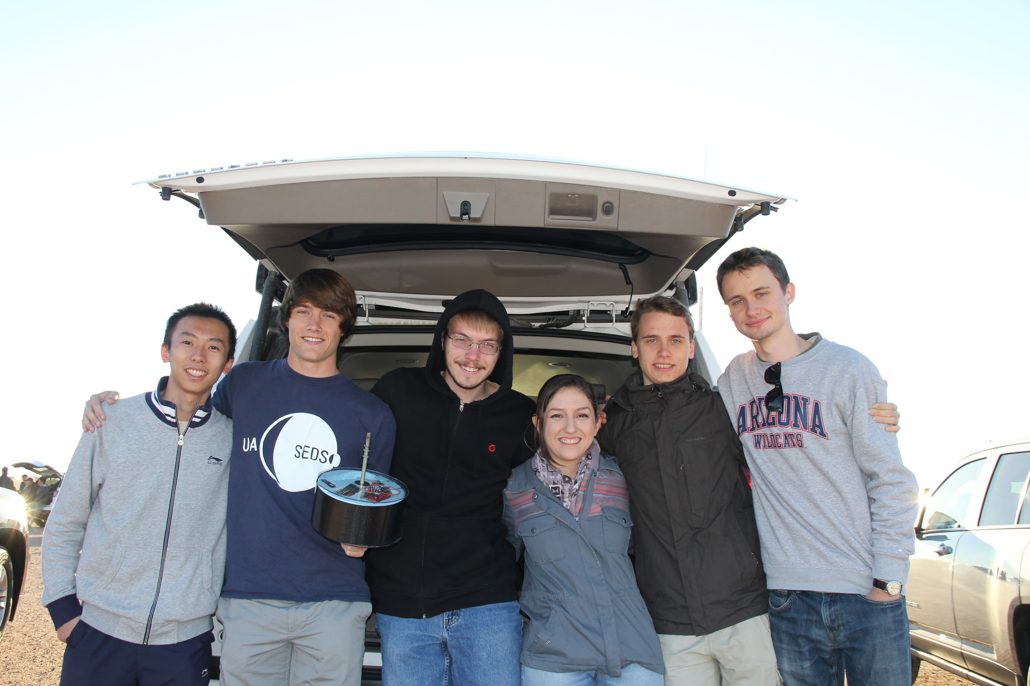
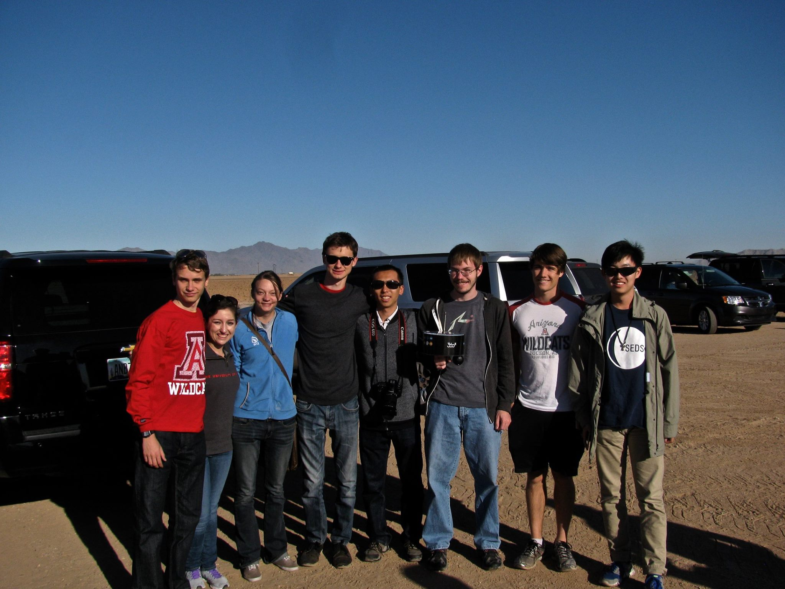

The Team
Ryan Stelzer
Callie Branyan
Andrew Siemens
Andras Szep
Marton Szep
Christina Loera
Xinyi Xu
Ruoyu Li

Slide 3




Acknowledgments

Slide 4
Outline
Objective
Method
Results
Conclusion

Slide 5
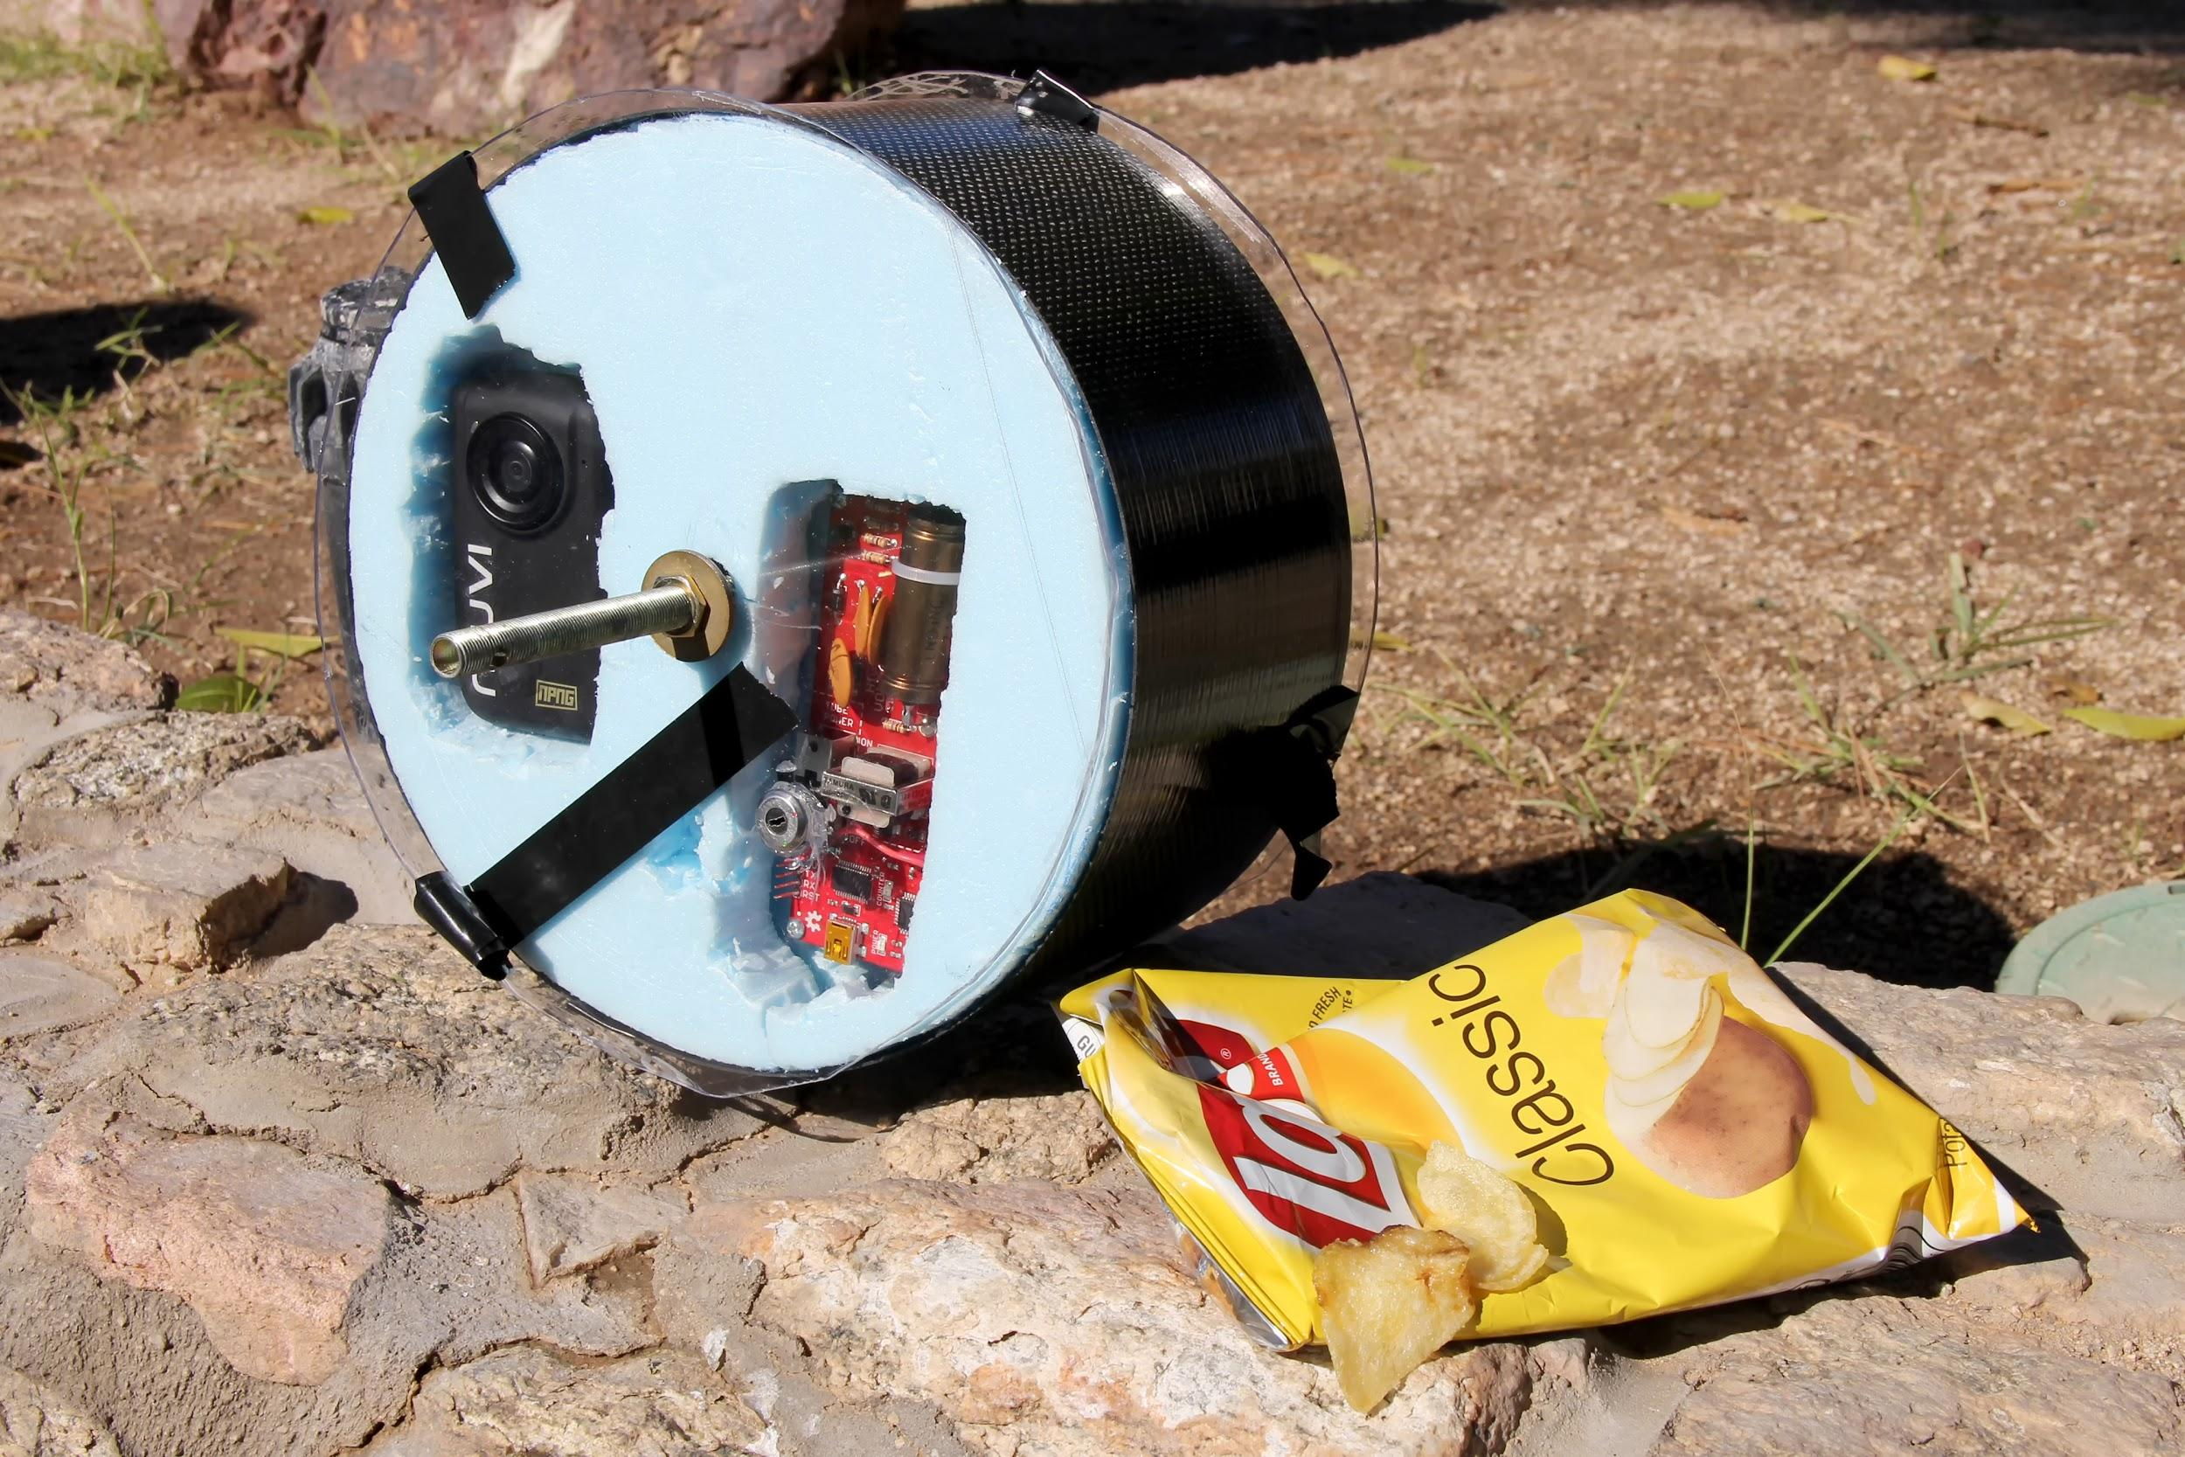
Fall Objective
Detect flux of muons throughout the flight
  Precursor experiment with Geiger counter
Detect UV levels with planned expansion to human health applications
Watch marshmallow expand
  Outreach video
Weather measurements
Notes:
Andras

Slide 6
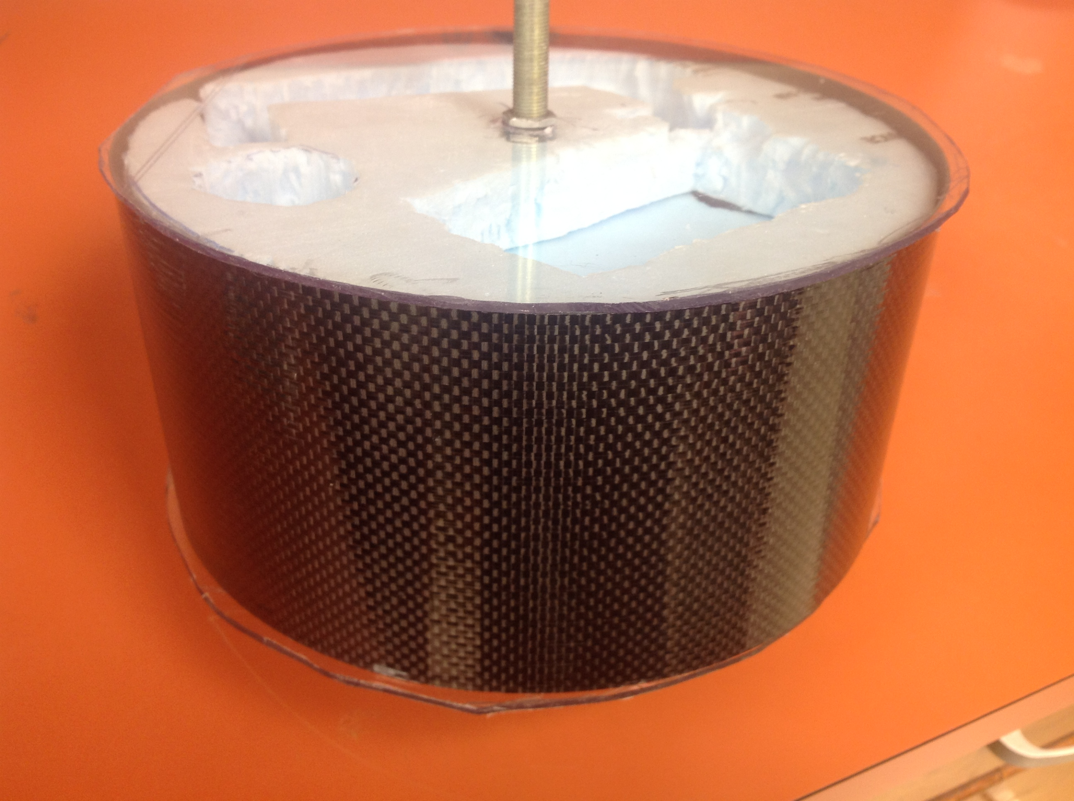
Structure
Carbon fiber cylinder
  Shell to protect the payload
Lexan Polycarbonate
  Used to cap the top and bottom of payload
Polystyrene Sheets
  Insulation and padding for the interior
Notes:
Andrew

Slide 7
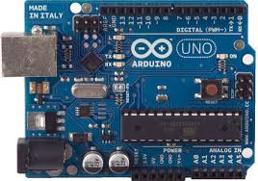
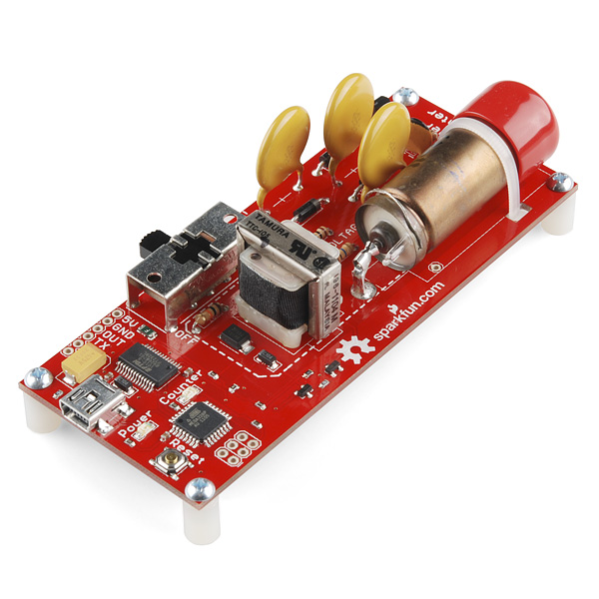
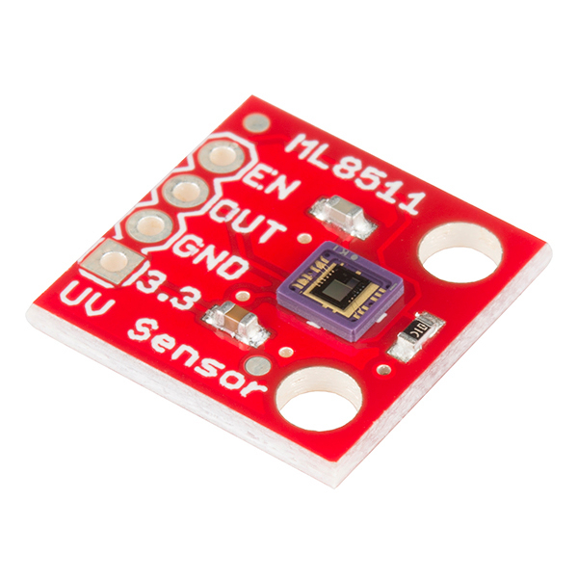
Fall Electronics #1
Arduino Uno
Geiger Counter
LND712 Geiger Tube @ 560V
ATMega328 Microcontroller
UV Sensor
ML8511 UV Sensor
Outputs an analog signal in relation to the amount of UV light it detects
Detects 290-380 nm wavelengths
Notes:
Christina- The first circuit is run by an Arduino Uno board powered by a 9-Volt battery.The Geiger counter sensor, containing a 560V tube, detects the relative count of muons and other elementary particles. The UV sensor detects ultraviolet radiation b/n 290-380 nm wavelengths.

Slide 8
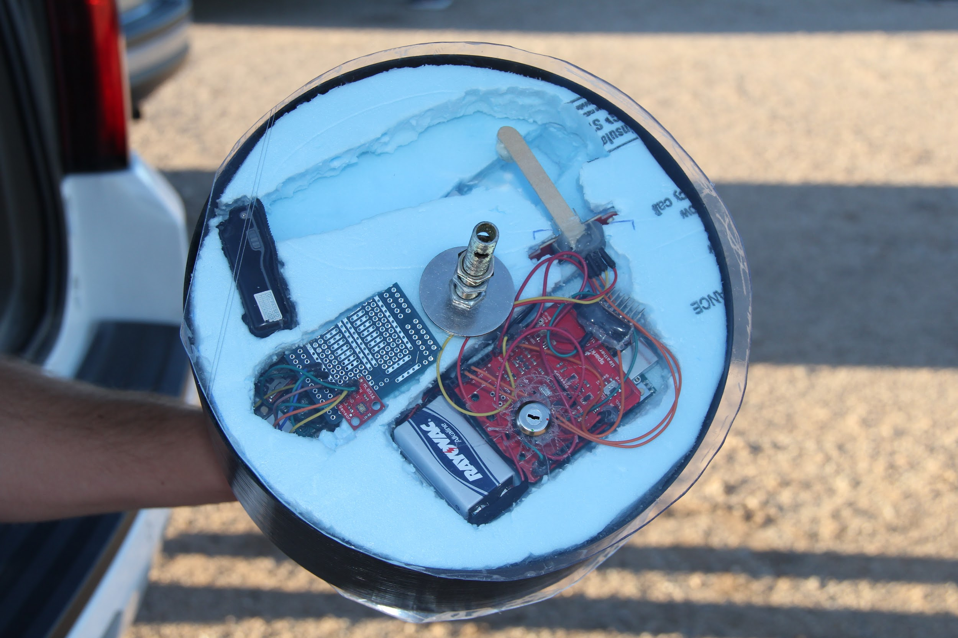
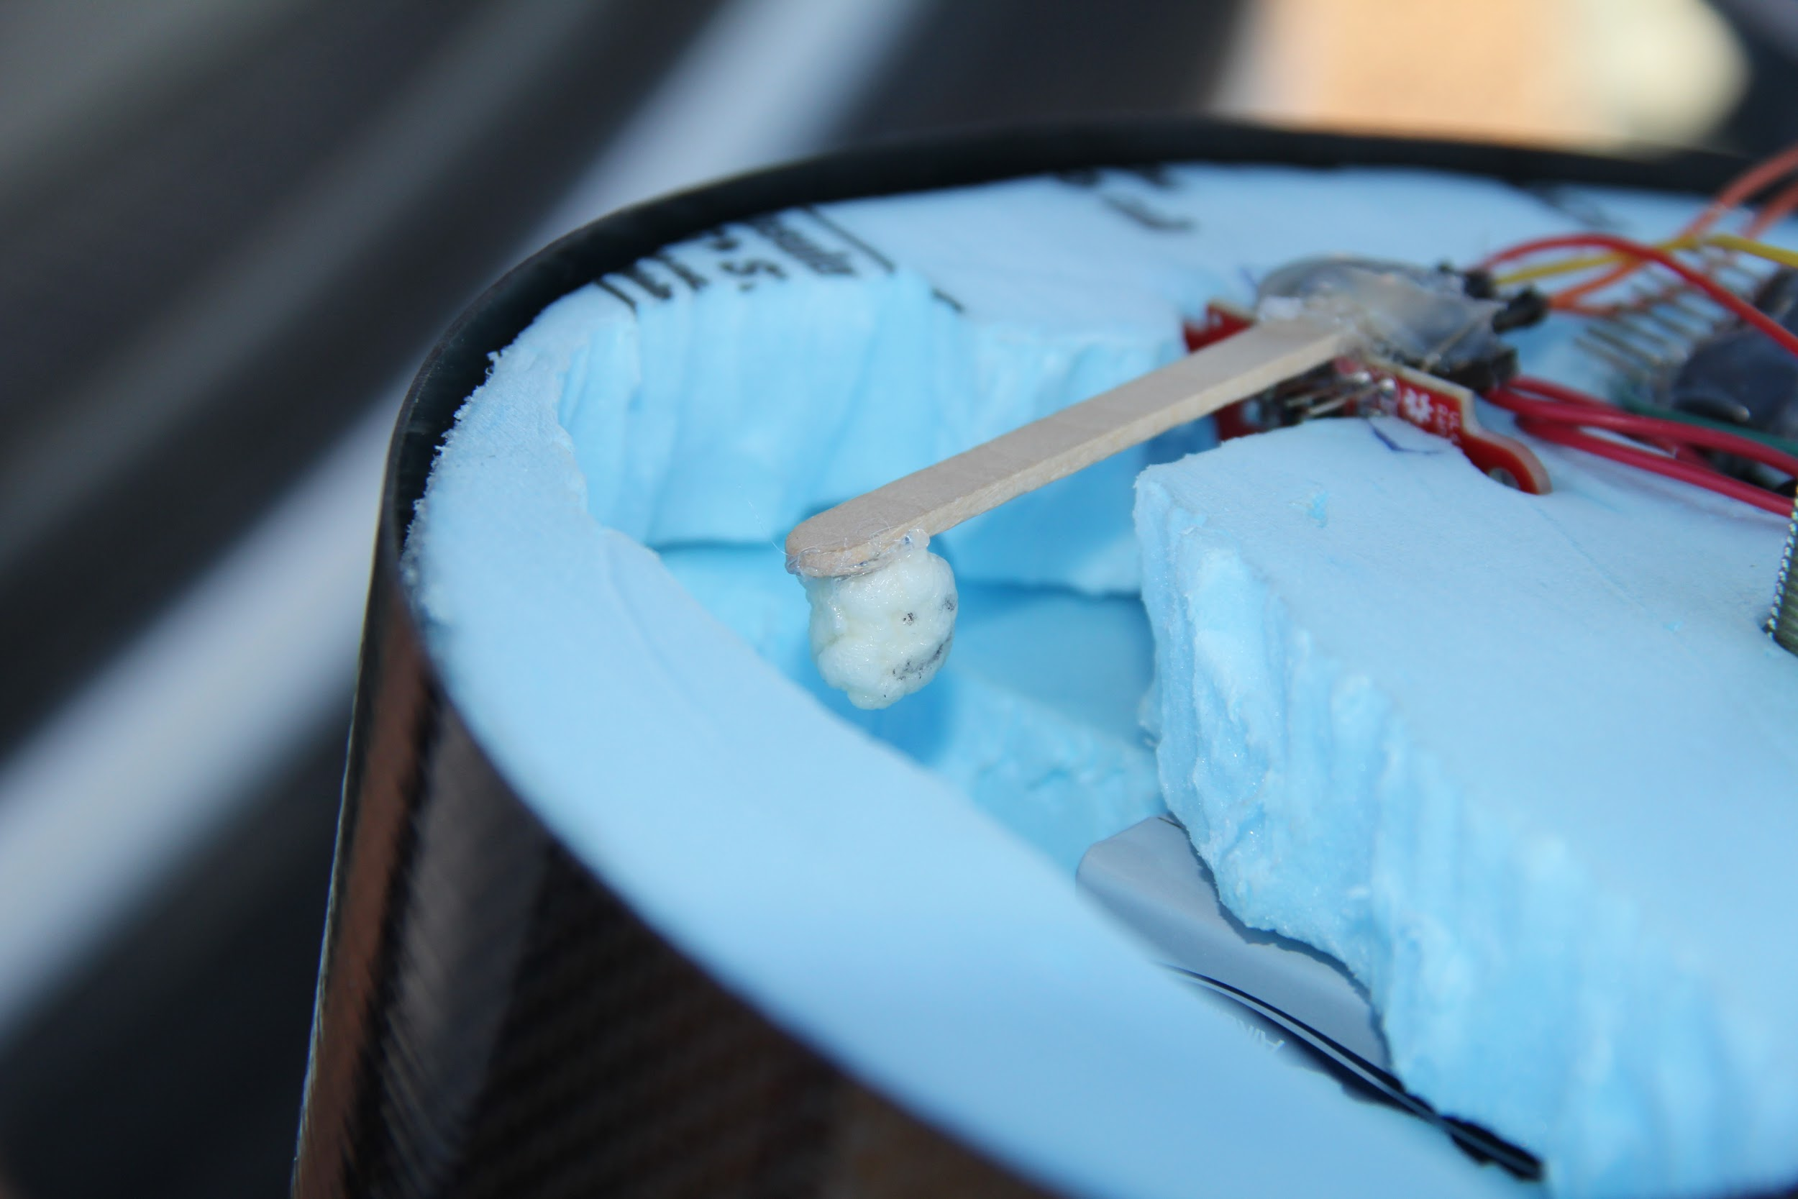
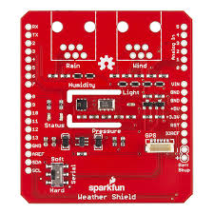
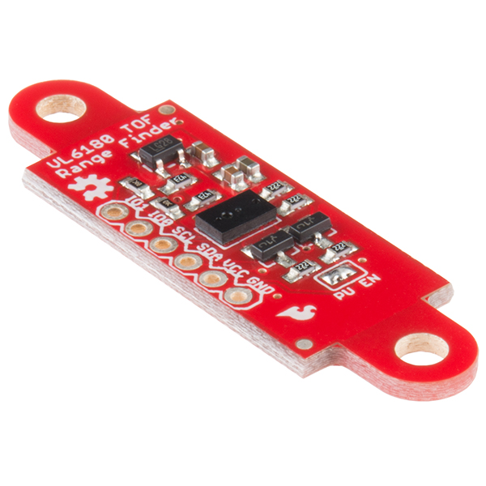
Fall Electronics #2
Arduino Uno
Sparkfun Weather Shield
Reads temperature, pressure, humidity, and luminosity all in one
Sparkfun ToF Range Finder
Measures distances up to 25cm in addition to measuring luminosity
Data to accompany marshmallow video
Notes:
Xinyi

Slide 9
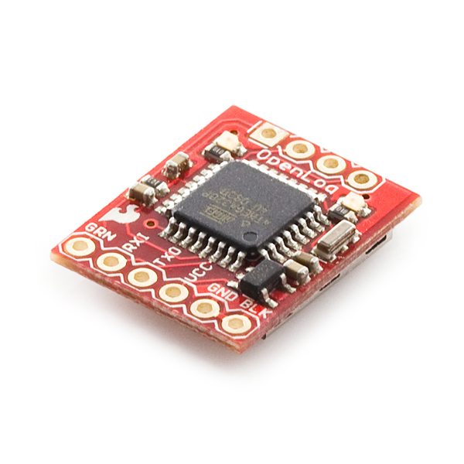
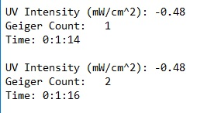
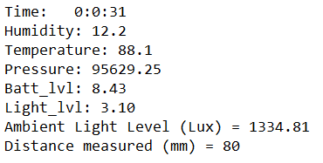
Data Logging
OpenLog
Serial output from Arduinos
Writes data onto MicroSD card
One for each electronics package
Sample logs
Images courtesy of Sparkfun Electronics
Notes:
Xinyi

Slide 10
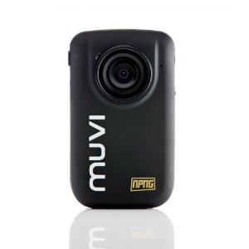
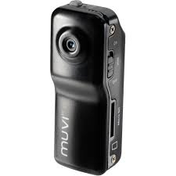
MUVI Cameras
Veho MUVI HD ActionCam
170 degree wide angle lens
5MP HD video resolution
8GB memory card
Pointed at ground
Veho Muvi Micro Action Cam
Very Compact
2MP video resolution
4GB memory card
Pointed at marshmallow
Both have internal batteries

Slide 11
Fall Results
Everything worked!!!
  Data from both Arduinos for whole flight
  MUVI camera footage for whole flight
Notes:
Andras

Slide 12
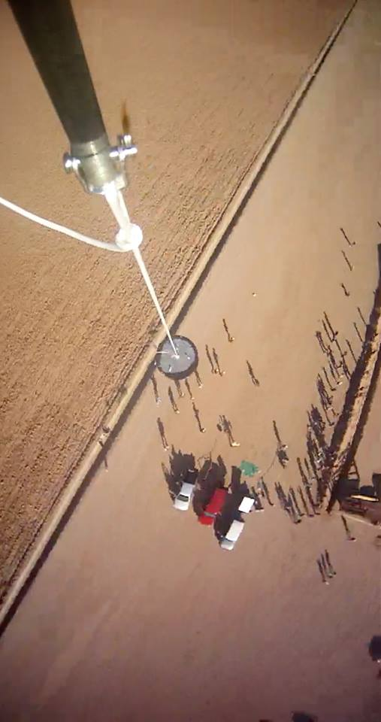
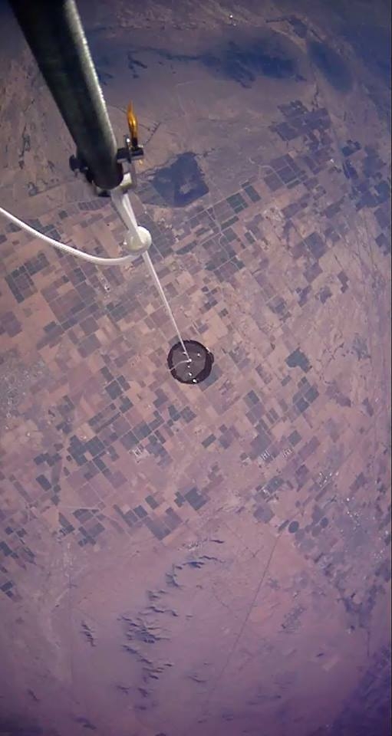
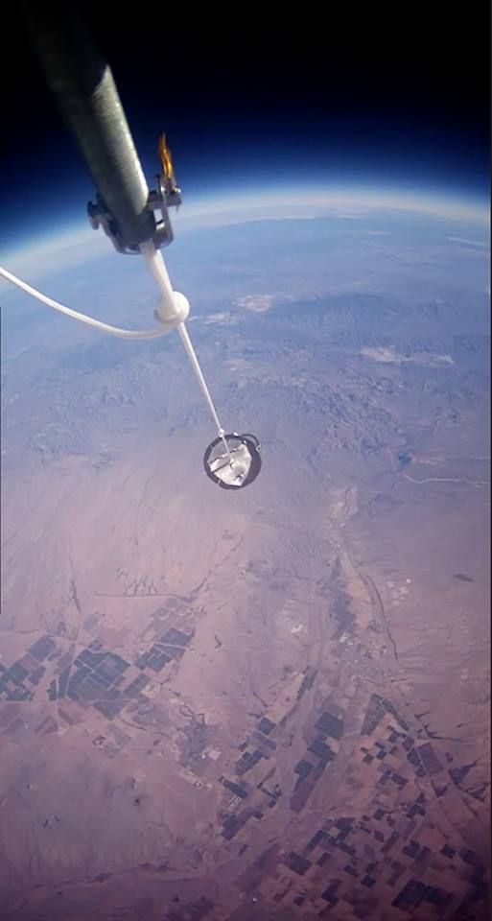
MUVI Camera

Slide 13
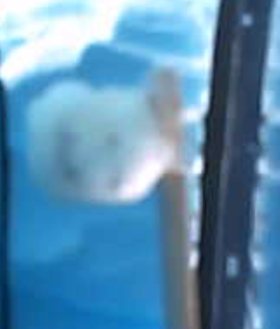
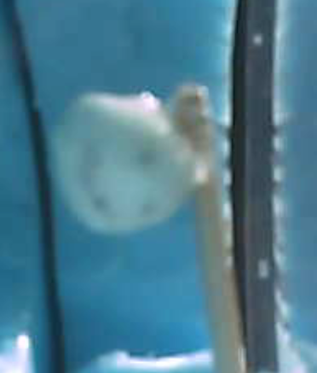

Marshmallow

Slide 14
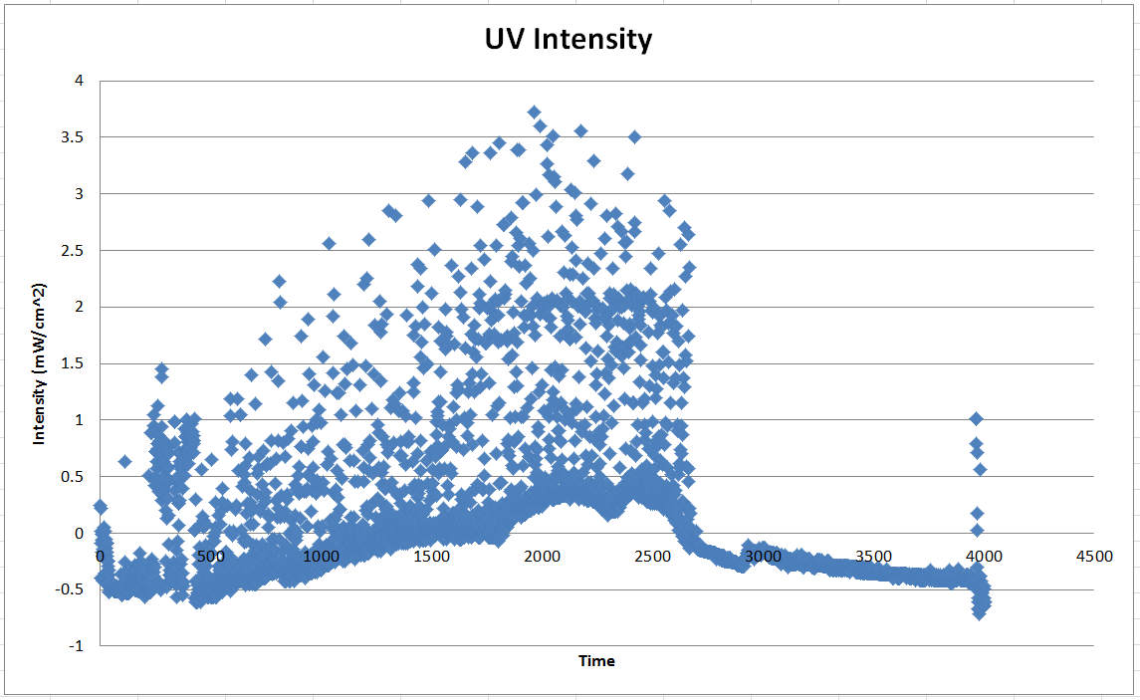
Fall Results

Slide 15
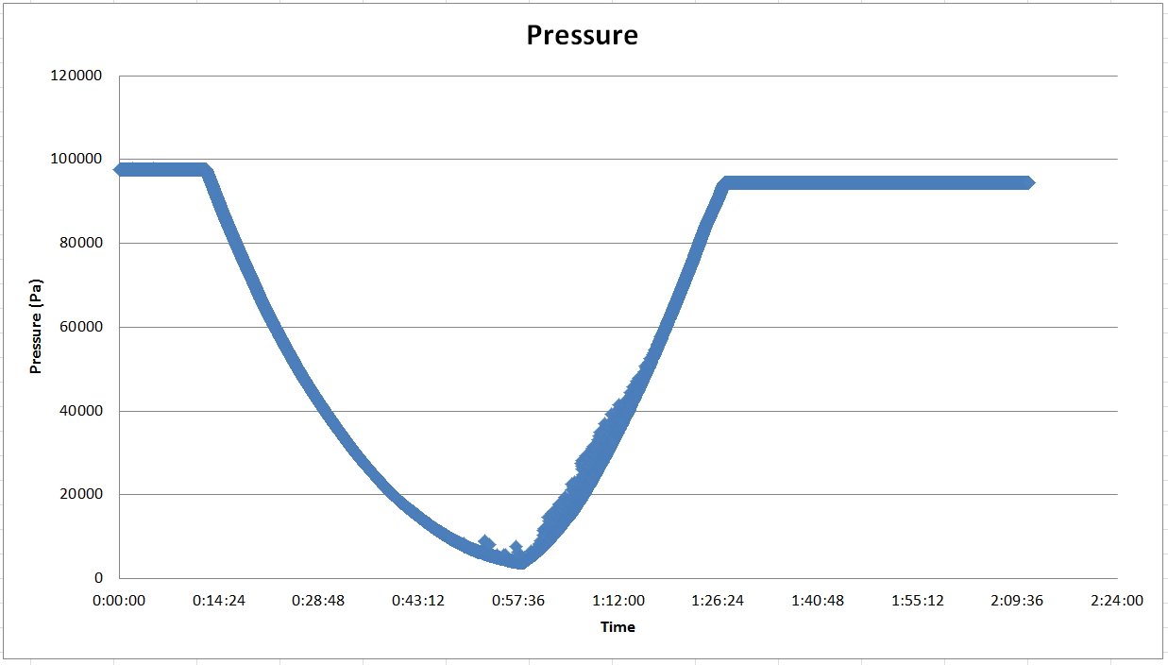
Fall Results

Slide 16
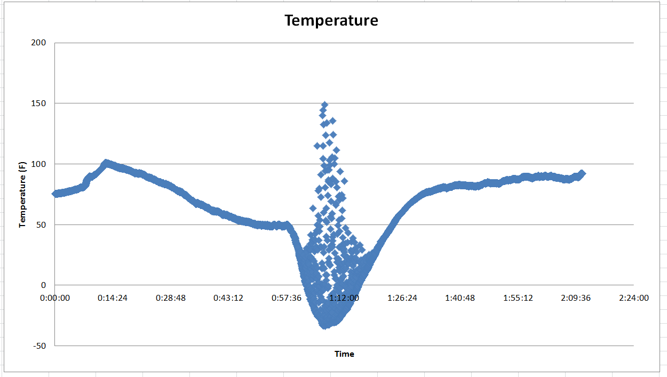
Fall Results

Slide 17
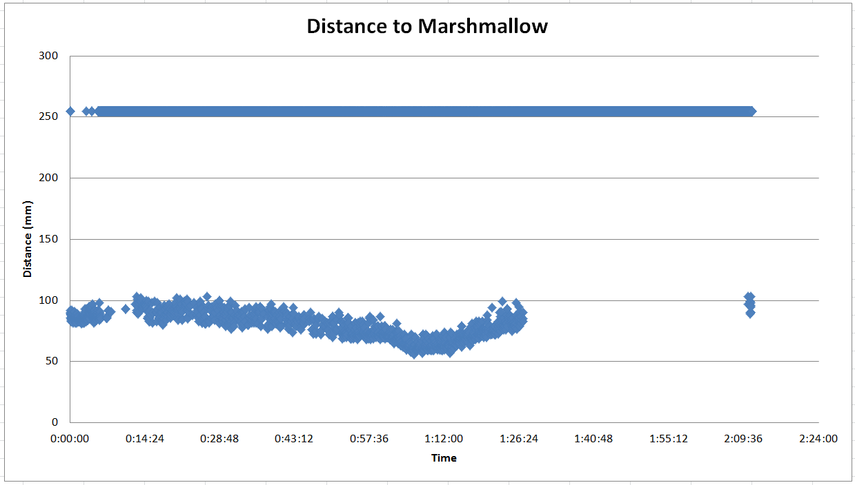
Fall Results

Slide 18
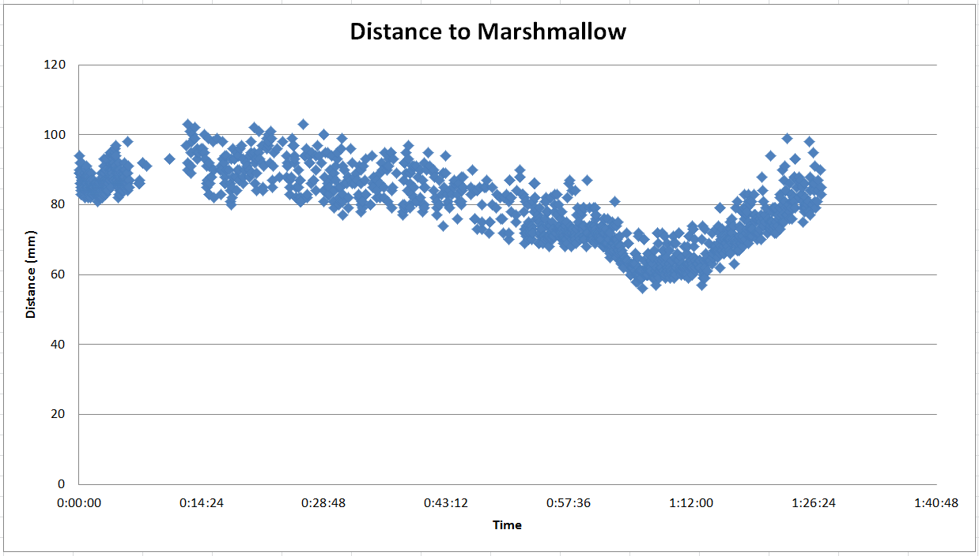
Fall Results

Slide 19
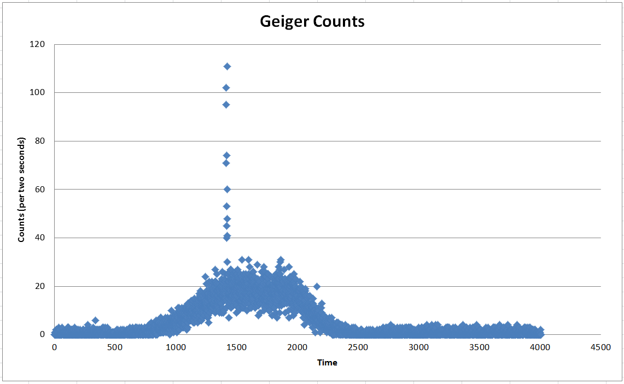
Fall Results

Slide 20
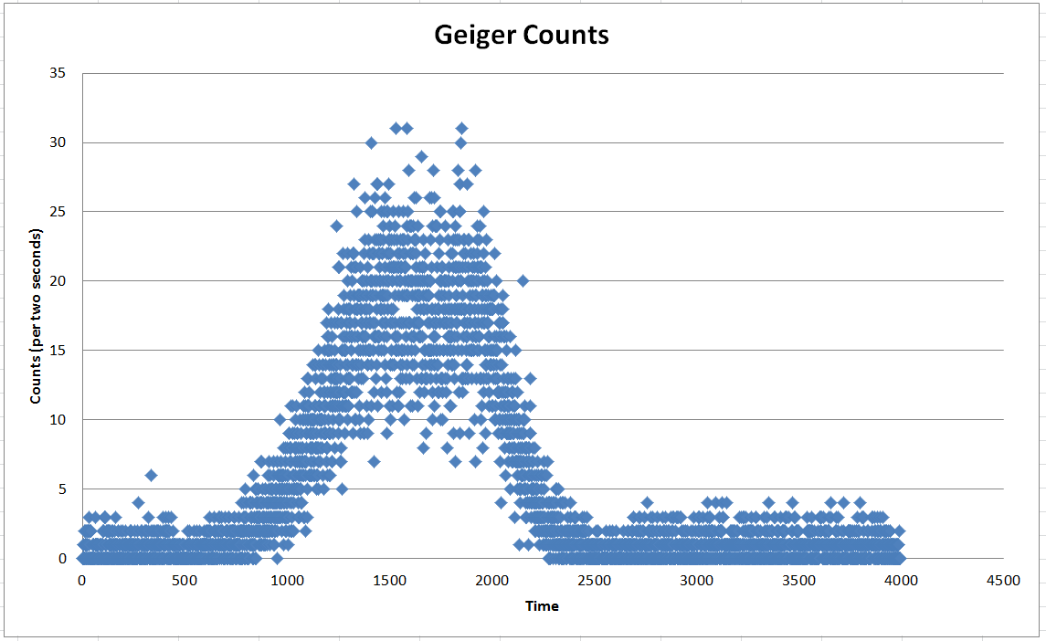
Fall Results

Slide 21
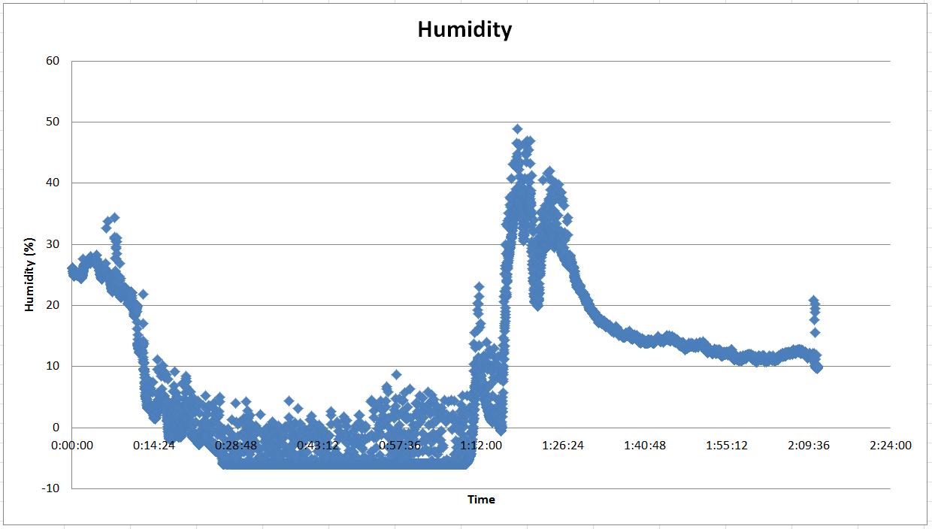
Fall Results

Slide 22
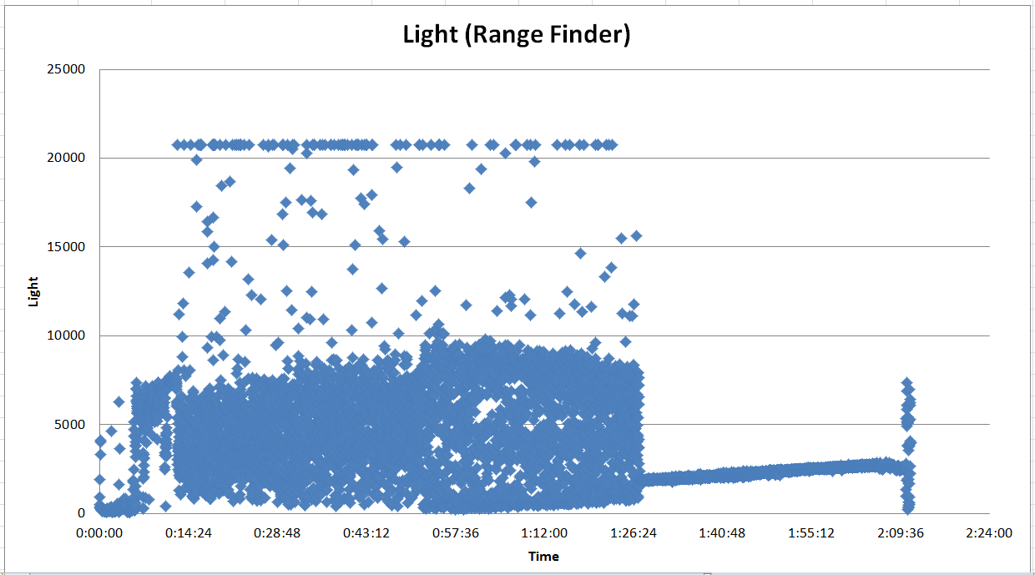
Fall Results

Slide 23
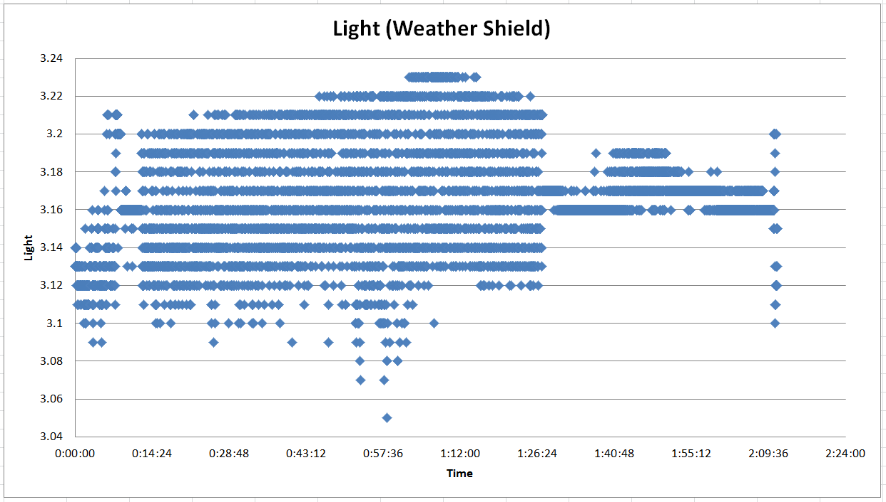
Fall Results

Slide 24
Spring Objective
Measure strain on the bottom of the payload
Measure UV, RGB, and Carbon Monoxide levels
Measure weather parameters
Muon detection from last semester was discontinued due to vague government threats about time travel
Notes:
2. Marton

Slide 25
Structure
Carbon fiber cylinder
  Shell to protect the payload
Lexan Polycarbonate
  Used to cap the top and bottom of payload
Polystyrene Sheets
  Insulation and padding for the interior
Notes:
Andrew

Slide 26
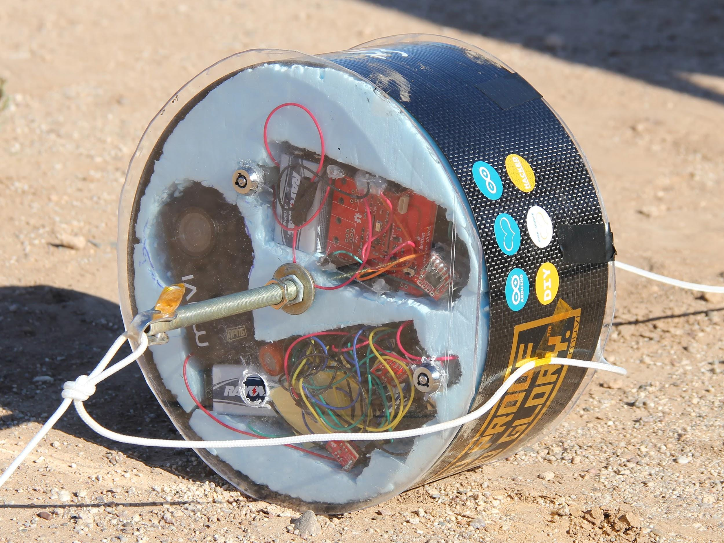
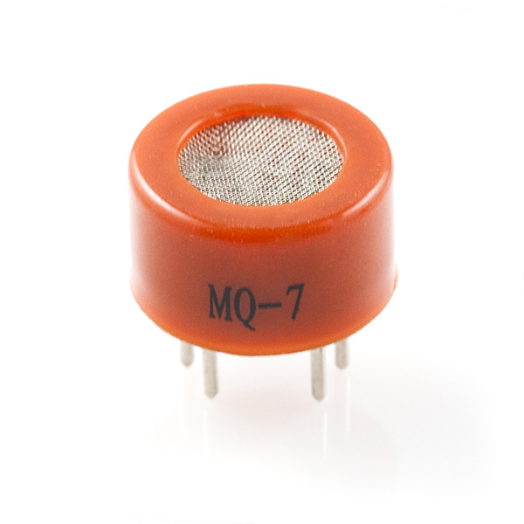
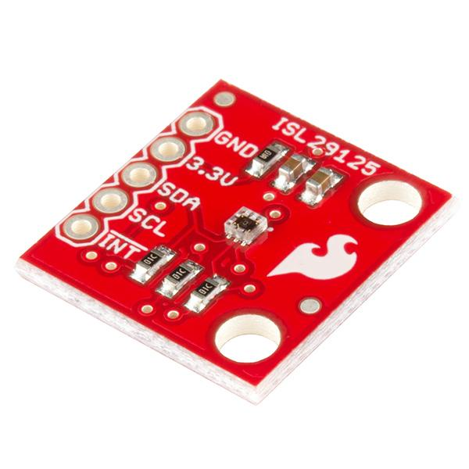
Spring Electronics #1
Arduino Uno
Ultraviolet Sensor
Carbon Monoxide Sensor
RGB Light Sensor
Notes:
Andrew

Slide 27
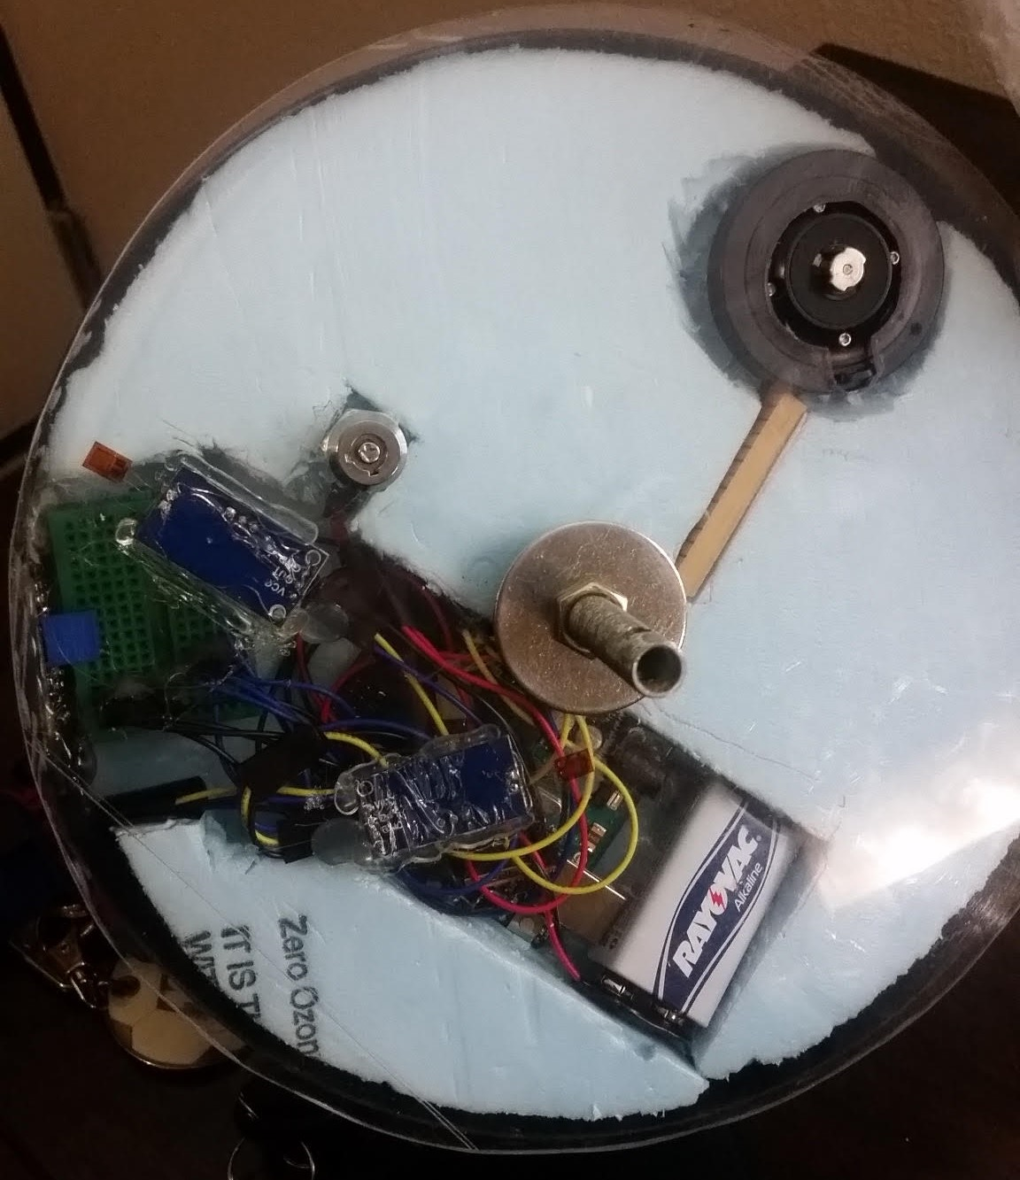
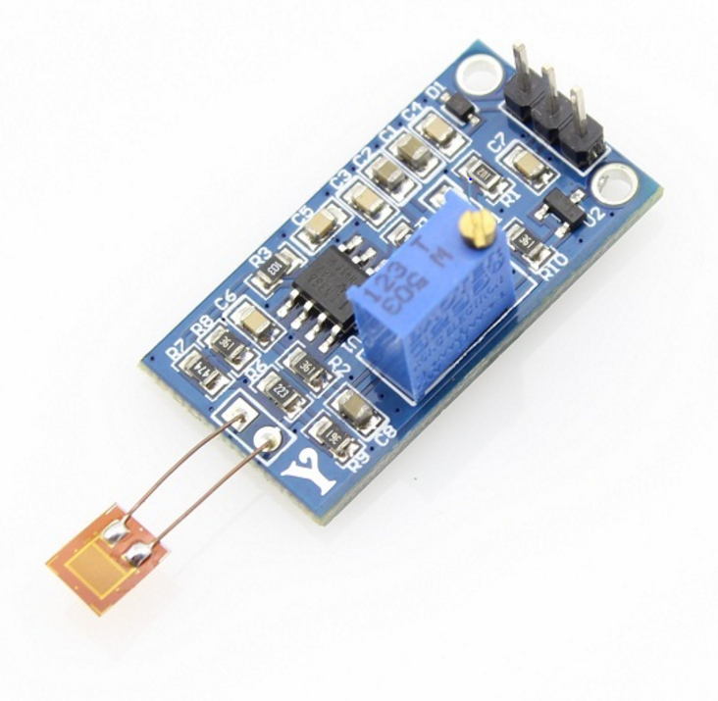
Spring Electronics #2
Arduino Uno
3 Strain gauges
On plastic near center
On plastic near edge
On carbon fiber
Notes:
Callie

Slide 28
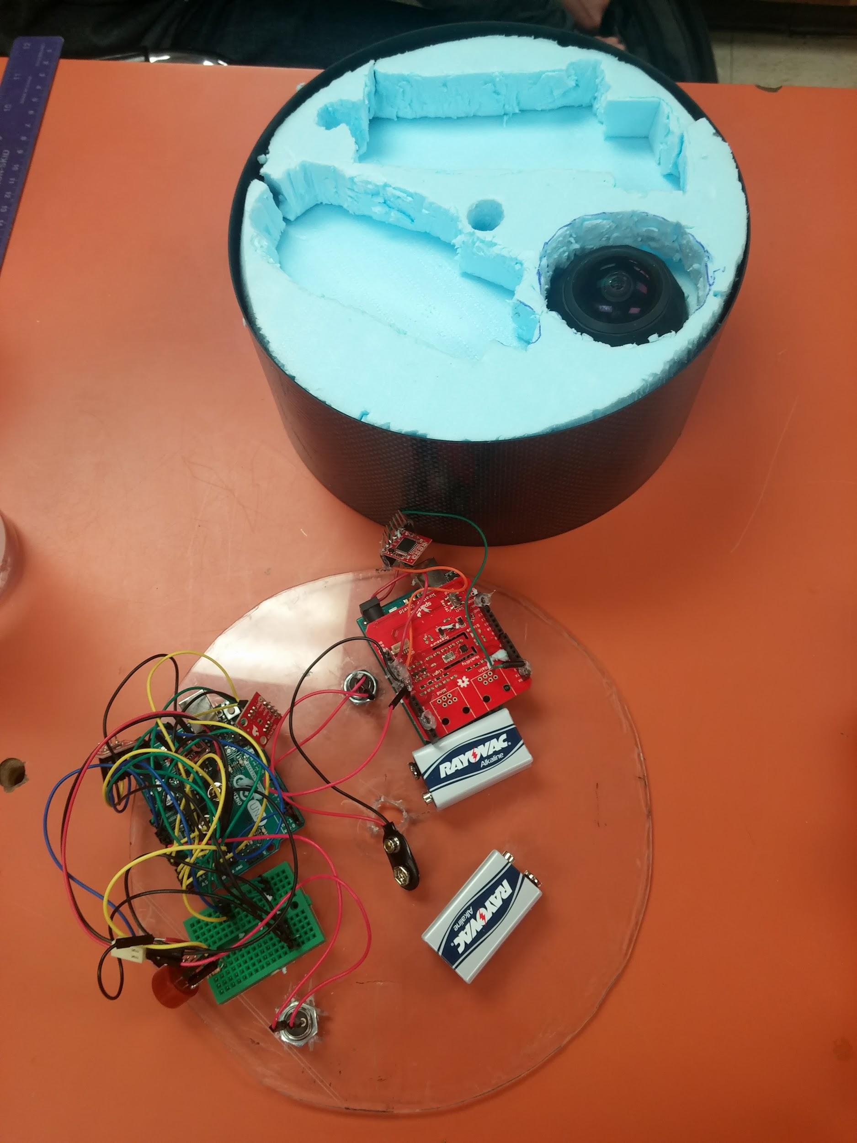
Spring Electronics #3
Arduino Uno
Sparkfun Weather Shield
Reads temperature, pressure, humidity, and luminosity all in one
Notes:
Christina

Slide 29
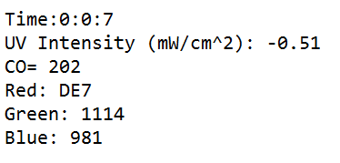
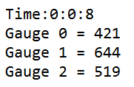
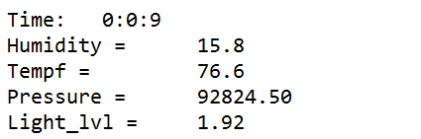
Data Logging
OpenLog
Serial output from Arduinos
Writes data onto MicroSD card
One for each electronics package
Sample logs
Images courtesy of Sparkfun Electronics
Notes:
Xinyi

Slide 30
MUVI Camera
Veho MUVI HD ActionCam
170 degree wide angle lens
5MP HD video resolution
Pointed upwards
Extensive flight heritage
Notes:
Andras

Slide 31
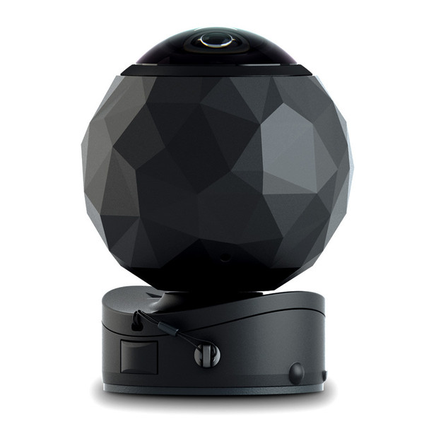
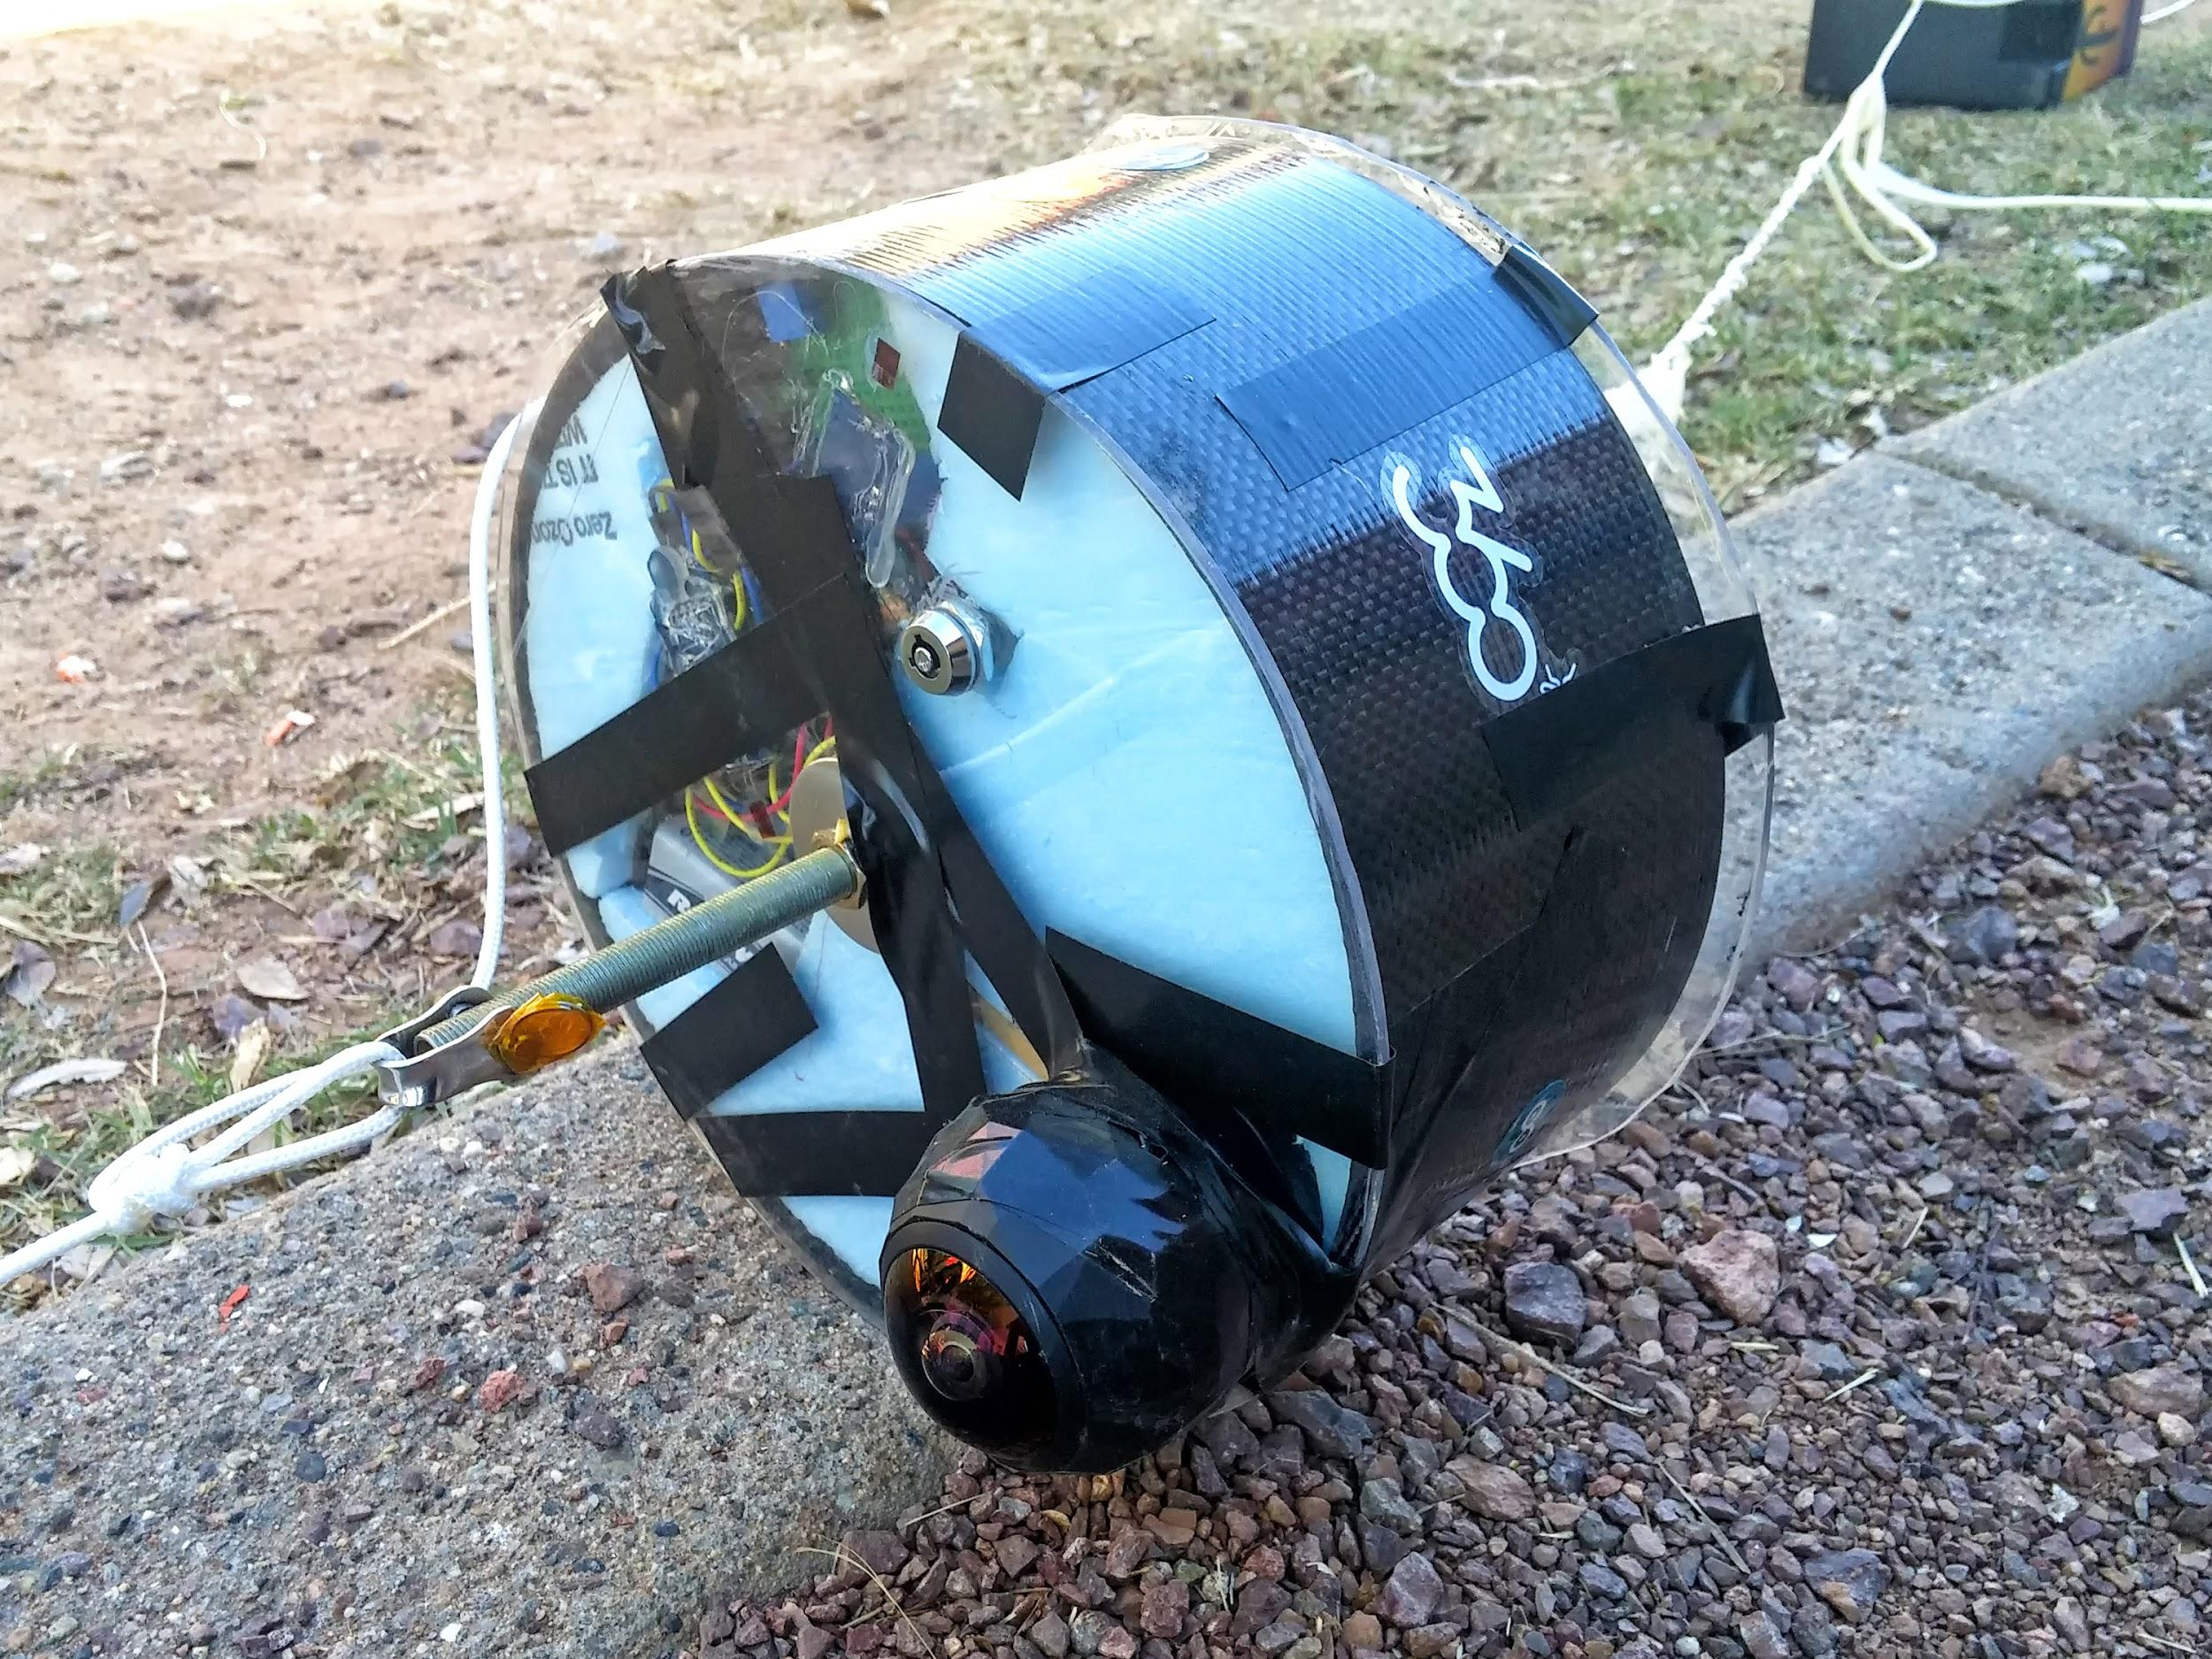
360Fly
Produces 360° videos
240 degree field of view camera
1504 x 1504 @ 30fps
Shock resistant
Notes:
Andras

Slide 32
Spring Results
360Fly worked!
  Ran out of batteries during descent
MUVI camera ran out of storage before pop
  Files were much larger than previous flights
  Resolution setting changed?
Weather shield worked!
Strain and UV/RGB/CO circuits did not work
  Bad wiring connections?
Notes:
Andras

Slide 33
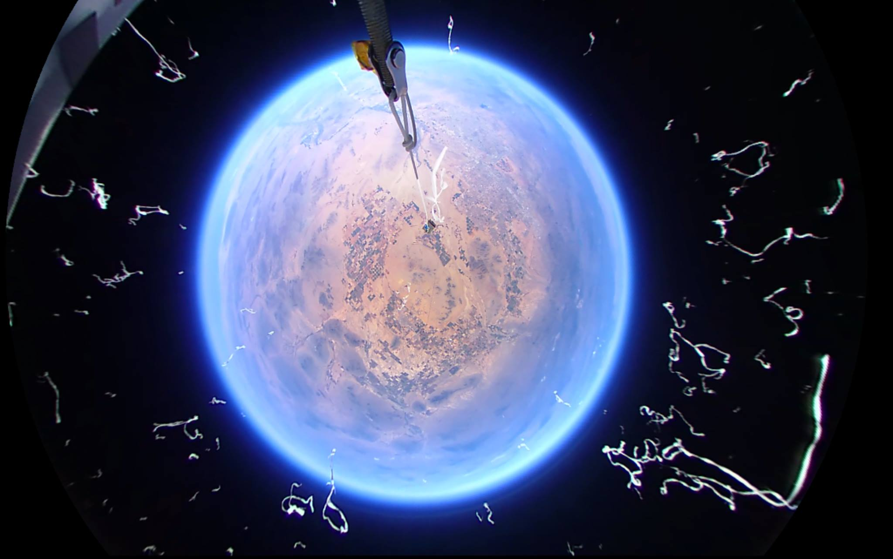
360 Degree High-Altitude Balloon Flight - UA ASCEND 2016 Spring
https://www.youtube.com/watch?v=SPtO2hVXbfM
Pop at 4:30

Slide 34
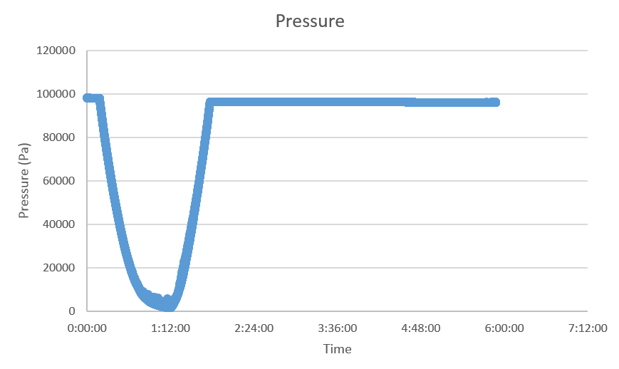
Spring Results

Slide 35
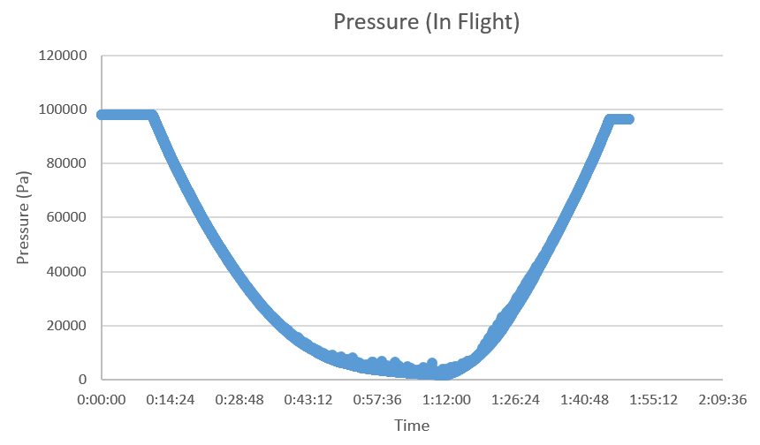
Spring Results

Slide 36
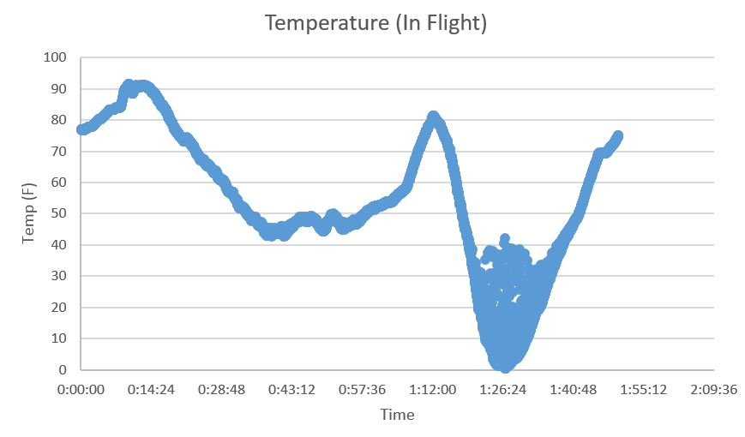
Spring Results

Slide 37
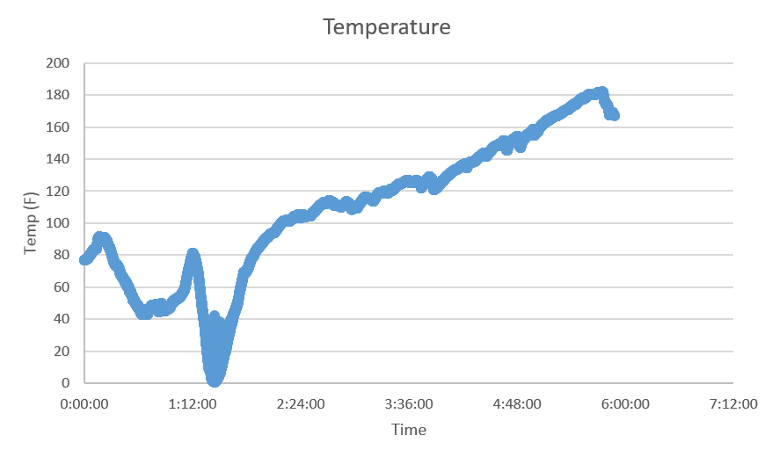
Spring Results

Slide 38
Conclusion
Fall semester was a complete success
  All sensors & camera worked
Discontinued muon experiment
Spring semester was a partial success
  360Fly worked
  MUVI partly worked
  Weather sensors worked
  Other sensors did not work

Slide 39
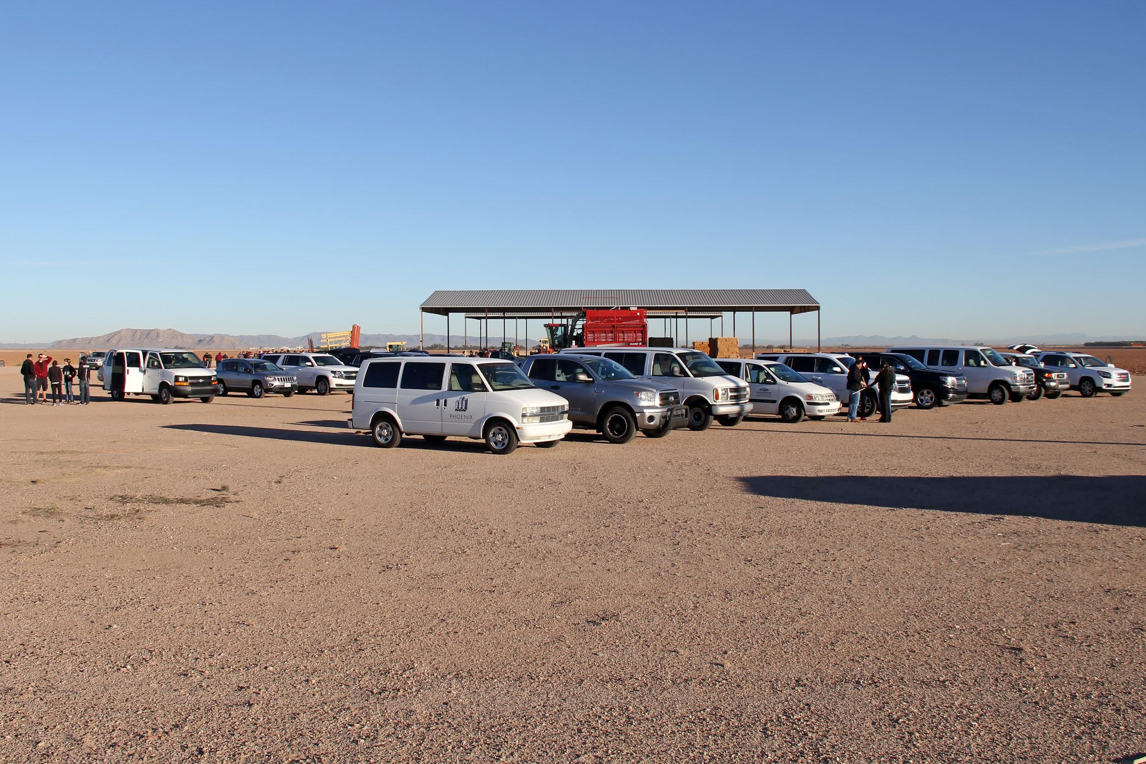
Pictures

Slide 40
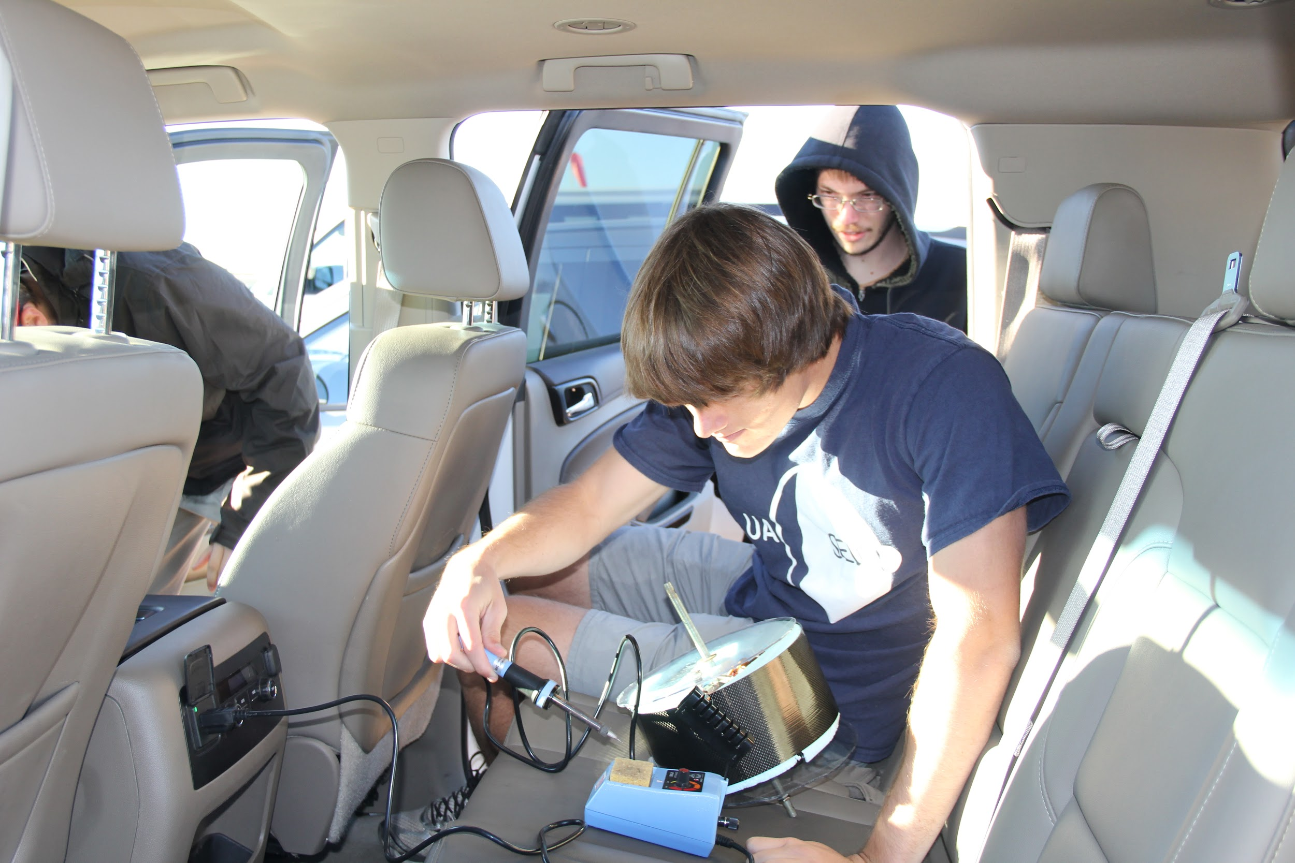
Fall
Launch

Slide 41
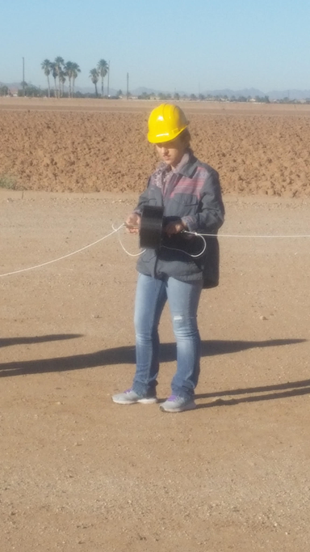

Slide 42



Slide 43


Slide 44

Fall Landing Site

Slide 45


Slide 46


Slide 47


Spring
Launch

Slide 48



Slide 49


Slide 50

Spring Landing Site
Unfortunately we weren’t able to go

Slide 51
Thank you!

